Slide 1
WEB lapas ceļojumu biedru atrašanai izstrāde
KVALIFIKĀCIJAS IEGUVEI
PROGRAMMĒŠANAS TEHNIĶIS
EVELĪNA FRĪDENBERGA – TOMAŠA 410. GRUPA

Slide 2
Projekta uzdevumi:
Izveidot reģistrācijas un pieteikšanās lapas
Izstrādāt lietotāja profila logu ar ceļojumu vēsturi un plāniem.
Sagatavot lietotāja ceļvedi
Izstrādāt navigācijas joslu
Veikt esošo ceļojumu biedru platformu analīzi
Izveidot galveno lapu ar lietotāju ceļojumu stāstiem un galamērķiem
Nodrošināt iespēju komunicēt ar ceļojuma biedriem
Izveidot lapu ar biežāk uzdotajiem jautājumiem
2

Slide 3













Izmantotās tehnoloģijas
Visual Studio Code
Git
MySQL
SQL
TailwindCSS
GitHub
Amazon Web Servoces
CSS
HTML
PHP
JavaScript
Laravel
3

Slide 4
Personīgie mērķi
01
02
03
04
Tehnoloģiju apguve
Uzlabot prasmes un zināšanas par mūsdienu tehnoloģijām un programmēšanas valodām
Sadarbības un komunikācijas prasmes
Uzlabot spēju strādāt komandā klients - izpildītājs
Projekta plānošana
Attīstīt spējas projektu plānošanā, izstrādē un vadībā
Portfolio veidošana
Izmantot projektu kā iespēju to demonstrēt turpmāk potenciālajiem darba devējie
4

Slide 5
Specifika
Iespēja pievienot un dalīties ar ceļojumu stāstiem un plāniem
Iespēja meklēt ceļojumu galamērķus un izteikt interesi tiem pievienoties
Iespēja apskatīt potenciālos ceļojuma biedrus un sazināties ar tiem
5

Slide 6
Contents of this template
You can delete this slide when you’re done editing the presentation
Fonts | To view this template correctly in PowerPoint, download and install the fonts we used
Used and alternative resources | An assortment of graphic resources that are suitable for use in this presentation
Thanks slide | You must keep it so that proper credits for our design are given
Colors | All the colors used in this presentation
Icons and infographic resources | These can be used in the template, and their size and color can be edited
Editable presentation theme | You can edit the master slides easily. For more info, click here
For more info:
SLIDESGO | SLIDESGO SCHOOL | FAQs
You can visit our sister projects:
FREEPIK | FLATICON | STORYSET | WEPIK | VIDEVO

Slide 7
Table of contents
01
02
03
04
Problem vs solution
You can describe the topic of the section here
Production
You can describe the topic of the section here
Market & competition
You can describe the topic of the section here
Business model
You can describe the topic of the section here

Slide 8
Introduction
This can be the part of the presentation where you introduce yourself, write your email…

Slide 9
Our company
Venus has a beautiful name and is the second planet from the Sun. It’s terribly hot, even hotter than Mercury, and its atmosphere is extremely poisonous. It’s the second-brightest natural object in the night sky after the Moon

Slide 10
Name of the section
01
You can enter a subtitle here if you need it

Slide 11

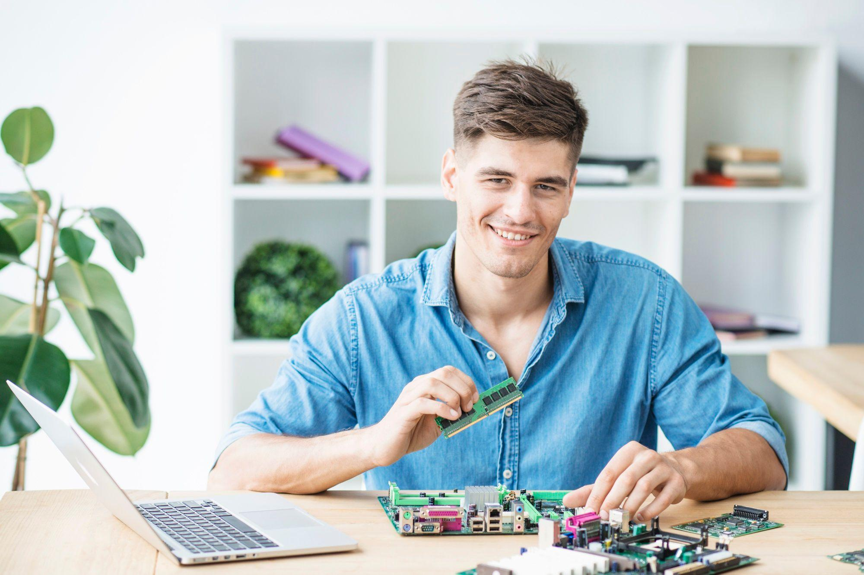

Our team
Sofia Hill
John James
Jane Patterson
You can speak a bit about this person here
You can speak a bit about this person here
You can speak a bit about this person here

Slide 12
Do you need longer text?
Mercury is the closest planet to the Sun and the smallest one in the entire Solar System. This planet's name has nothing to do with the liquid metal, since Mercury was named after the Roman messenger god. Despite being closer to the Sun than Venus, its temperatures aren't as terribly hot as that planet's. Its surface is quite similar to that of Earth's Moon, which means there are a lot of craters and plains
Speaking of craters, many of them were named after artists or authors who made significant contributions to their respective fields. Mercury takes a little more than 58 days to complete its rotation, so try to imagine how long days must be there! Since the temperatures are so extreme, albeit not as extreme as in Venus, and the solar radiation is so high, Mercury has been deemed to be non-habitable for humans

Slide 13
Problem
Do you know what helps you make your point clear? Lists like this one:
They’re simple
You can organize your ideas clearly
You’ll never forget to buy milk!
And the most important thing: the audience won’t miss the point of your presentation

Slide 14
Them / Us
Them
Us
Mercury is the closest planet to the Sun and the smallest one in the Solar System—it’s a bit larger than the Moon
Venus has a beautiful name and is the second planet from the Sun. It’s hot and has a really poisonous atmosphere

Slide 15
Swot analysis
Strengths
Weakness
Mars is actually a very cold place
Venus has extremely high temperatures
Opportunities
Threats
Jupiter is the biggest planet of them all
Saturn is a gas giant and has several rings

Slide 16
Product overview
Mars
Venus
Neptune
Mars is actually a very cold place
Venus has extremely high temperatures
Neptune is far away from us
Mercury
Saturn
Jupiter
It’s the closest planet to the Sun
Saturn is a gas giant with several rings
Jupiter is the biggest planet of them all

Slide 17
AWESOME WORDS

Slide 18
—Someone Famous
“This is a quote, words full of wisdom that someone important said and can make the reader get inspired.”

Slide 19
Our plans
$50
$100
$200
Basic
Pro
Premium
Mercury is the closest planet to the Sun
Venus has a really beautiful name
Despite being red, Mars is actually a cold place

Slide 20
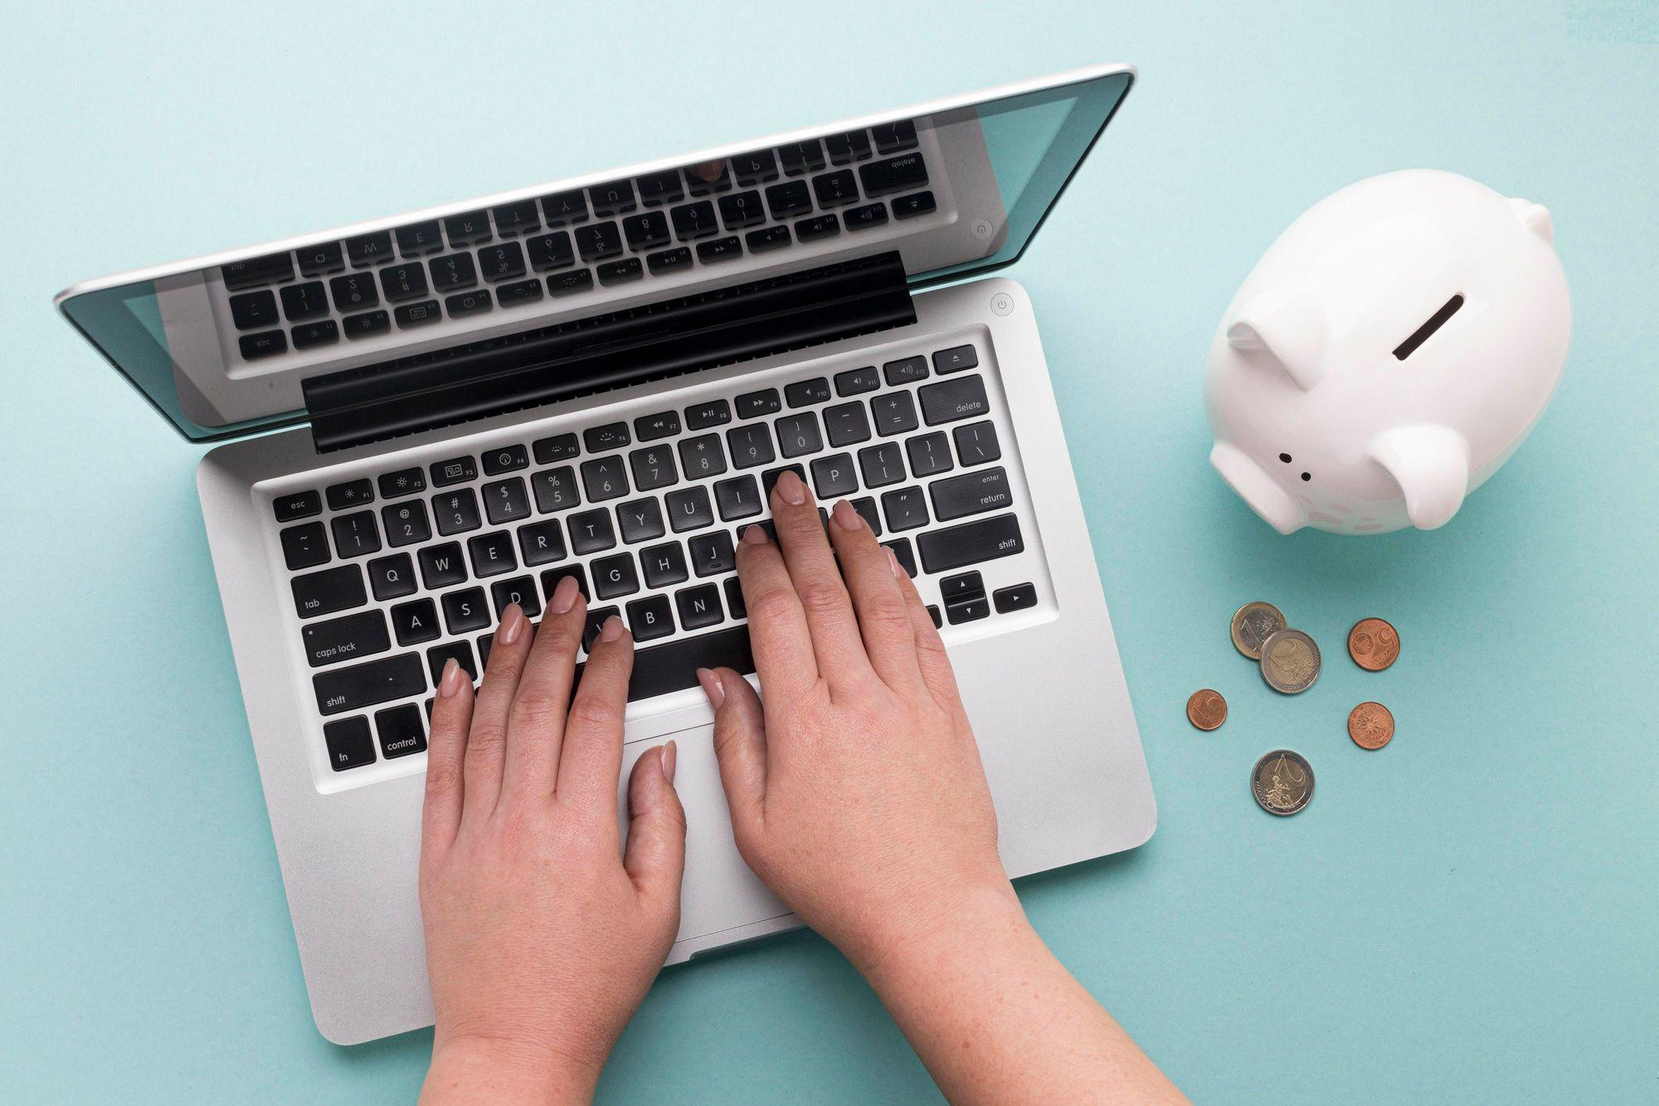
Product demo
You can replace the image on the screen with your own work. Just right-click on it and select “Replace image”

Slide 21
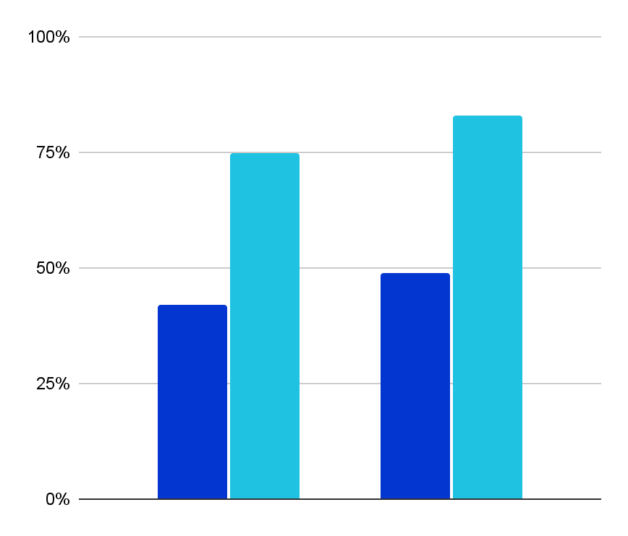
Our traction
$243,000
$142
Average revenue in 2XXX
User savings per deal
2XXX
2XXX
3,462
78,000
Mars
Venus
Registered businesses
Total app downloads
Follow the link in the graph to modify its data and then paste the new one here. For more info, click here

Slide 22
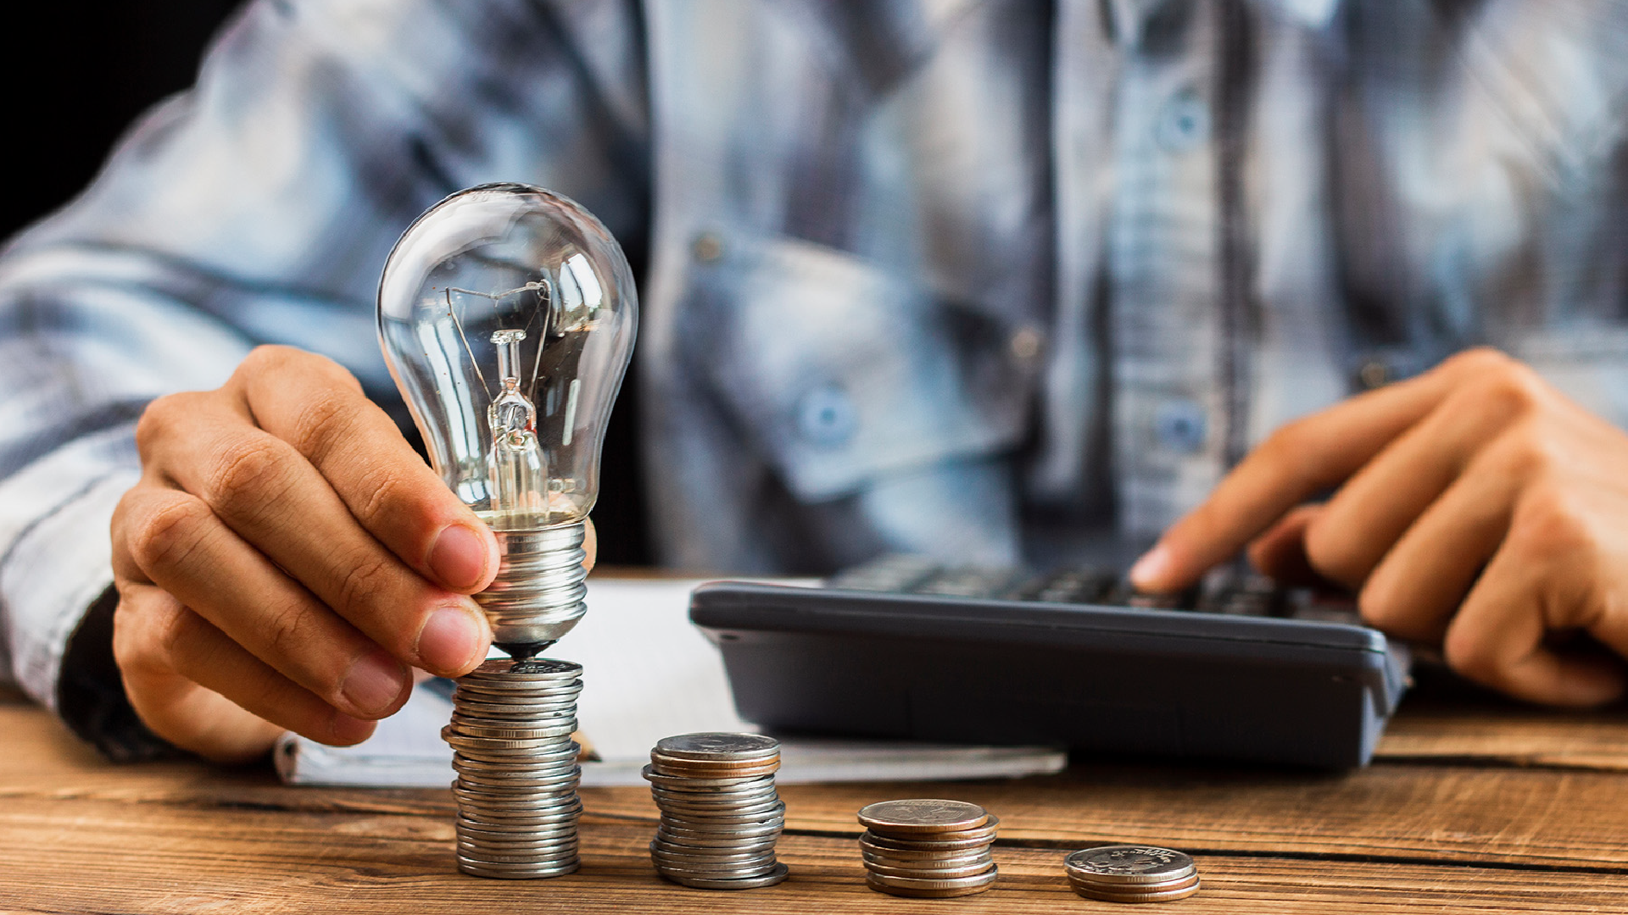
A PICTURE IS WORTH A THOUSAND WORDS

Slide 23
Case study
Challenge
Mercury is the closest planet to the Sun and the smallest one
Results
Venus has a beautiful name and is the second planet from the Sun
Solution
Despite being red, Mars is actually a cold place. It’s full of iron oxide

Slide 24
Some reviews
Jenna Doe
Timmy Jimmy
“Earth is the third planet from the Sun and the only one that harbors life in the Solar System. It’s where we all live”
“Despite being red, Mars is actually a cold place. It's full of iron oxide dust, which gives the planet its red cast”

Slide 25

A picture always reinforces
the concept
Images reveal large amounts of data, so remember: use an image instead of a long text. Your audience will appreciate it

Slide 26
15,768
Big numbers catch your audience’s attention

Slide 27
Awards
Mercury
Mercury is the closest planet to the Sun and the smallest one in the Solar System—it’s only a bit larger than the Moon
Venus
Venus has a beautiful name and is the second planet from the Sun. It’s terribly hot, even hotter than Mercury
Mars
Despite being red, Mars is actually a very cold place. It’s full of iron oxide dust, which gives the planet its reddish cast

Slide 28
Market size
54%
46%
Mars
Venus
Mars is actually a very cold place
Venus has extremely high temperatures
Earth is the third planet from the Sun and the only one that harbors life in the Solar System

Slide 29
Target
Gender
Age
32%
41%
27%
65%
23%
12%
Men
Women
Other
19-32
33-47
48-57
Hobbies
Mars
Venus
Saturn
Earth

Slide 30
Competitor analysis
Company 1 | Company 2 | Company 3 | Company 4
Venus has a beautiful name and is the second planet from the Sun | Mercury is the closest planet to the Sun and the smallest of them all | Earth is the third planet from the Sun and the only one that harbors life | Despite being red, Mars is actually a cold place. It's full of iron oxide dust
Venus | Mercury | Earth | Mars

Slide 31
Business model
Mercury
Marketing
Training
Assessment
Technology
Mars is actually a very cold place
Venus has extremely high temperatures
Neptune is really far away from us
Saturn is a gas giant with several rings

Slide 32
Project timing
Venus is the second planet from the Sun
Despite being red, Mars is a very cold place
Day 1
Day 3
Day 2
Day 4
Mercury is the closest planet to the Sun
Jupiter is the biggest planet of them all

Slide 33
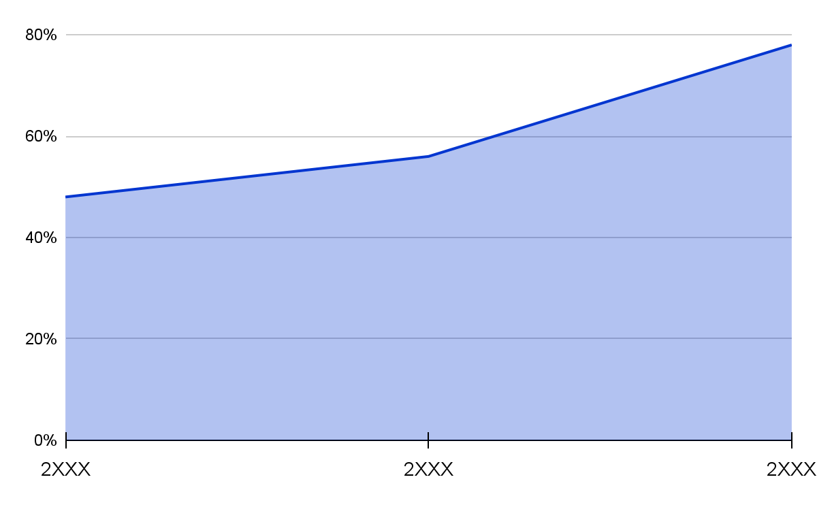
Predicted growth
From 2XXX-2XXX
Venus has a beautiful name and is the second planet from the Sun. It’s terribly hot, even hotter than Mercury, and its atmosphere is extremely poisonous
100
$20,000
Follow the link in the graph to modify its data and then paste the new one here. For more info, click here
New employees
Expected income

Slide 34

Investment
25%
23%
Mars
Venus
Mars is actually a very cold place
Venus has extremely high temperatures
32%
20%
Mercury
Saturn
It’s the closest planet to the Sun
Saturn is a gas giant with several rings
Follow the link in the graph to modify its data and then paste the new one here. For more info, click here

Slide 35
Thanks!
Do you have any questions?
youremail@freepik.com
+34 654 321 432
yourwebsite.com
Please keep this slide for attribution

Slide 36
Icon pack

Slide 37
Alternative resources
Here’s an assortment of alternative resources whose style fits that of this template:
Abstract style classic blue background

Slide 38
Resources
Did you like the resources on this template? Get them for free at our other websites:
Vectors
Abstract style classic blue background
Photos
Man cunting the stack of coins
Freelance worker using laptop
Nomad woman traveling with family
Smiling young male it technician with hardware equipment's
Young woman wearing embroidered shirt
Top view finance elements with white piggy ban
Icons
Icon Pack: Crowdfunding | Lineal

Slide 39
Instructions for use
If you have a free account, in order to use this template, you must credit Slidesgo by keeping the Thanks slide. Please refer to the next slide to read the instructions for premium users.
As a Free user, you are allowed to:
Modify this template.
Use it for both personal and commercial projects.
You are not allowed to:
Sublicense, sell or rent any of Slidesgo Content (or a modified version of Slidesgo Content).
Distribute Slidesgo Content unless it has been expressly authorized by Slidesgo.
Include Slidesgo Content in an online or offline database or file.
Offer Slidesgo templates (or modified versions of Slidesgo templates) for download.
Acquire the copyright of Slidesgo Content.
For more information about editing slides, please read our FAQs or visit Slidesgo School:
https://slidesgo.com/faqs and https://slidesgo.com/slidesgo-school

Slide 40
Instructions for use (premium users)
As a Premium user, you can use this template without attributing Slidesgo or keeping the "Thanks" slide.
You are allowed to:
Modify this template.
Use it for both personal and commercial purposes.
Hide or delete the “Thanks” slide and the mention to Slidesgo in the credits.
Share this template in an editable format with people who are not part of your team.
You are not allowed to:
Sublicense, sell or rent this Slidesgo Template (or a modified version of this Slidesgo Template).
Distribute this Slidesgo Template (or a modified version of this Slidesgo Template) or include it in a database or in any other product or service that offers downloadable images, icons or presentations that may be subject to distribution or resale.
Use any of the elements that are part of this Slidesgo Template in an isolated and separated way from this Template.
Register any of the elements that are part of this template as a trademark or logo, or register it as a work in an intellectual property registry or similar.
For more information about editing slides, please read our FAQs or visit Slidesgo School:
https://slidesgo.com/faqs and https://slidesgo.com/slidesgo-school

Slide 41
Fonts & colors used
This presentation has been made using the following fonts:
Albert Sans
(https://fonts.google.com/specimen/Albert+Sans)
#191919
#ffffff
#002080
#0336d0
#1382db
#1fc2e1
#08e0db
#03fcd5

Slide 42

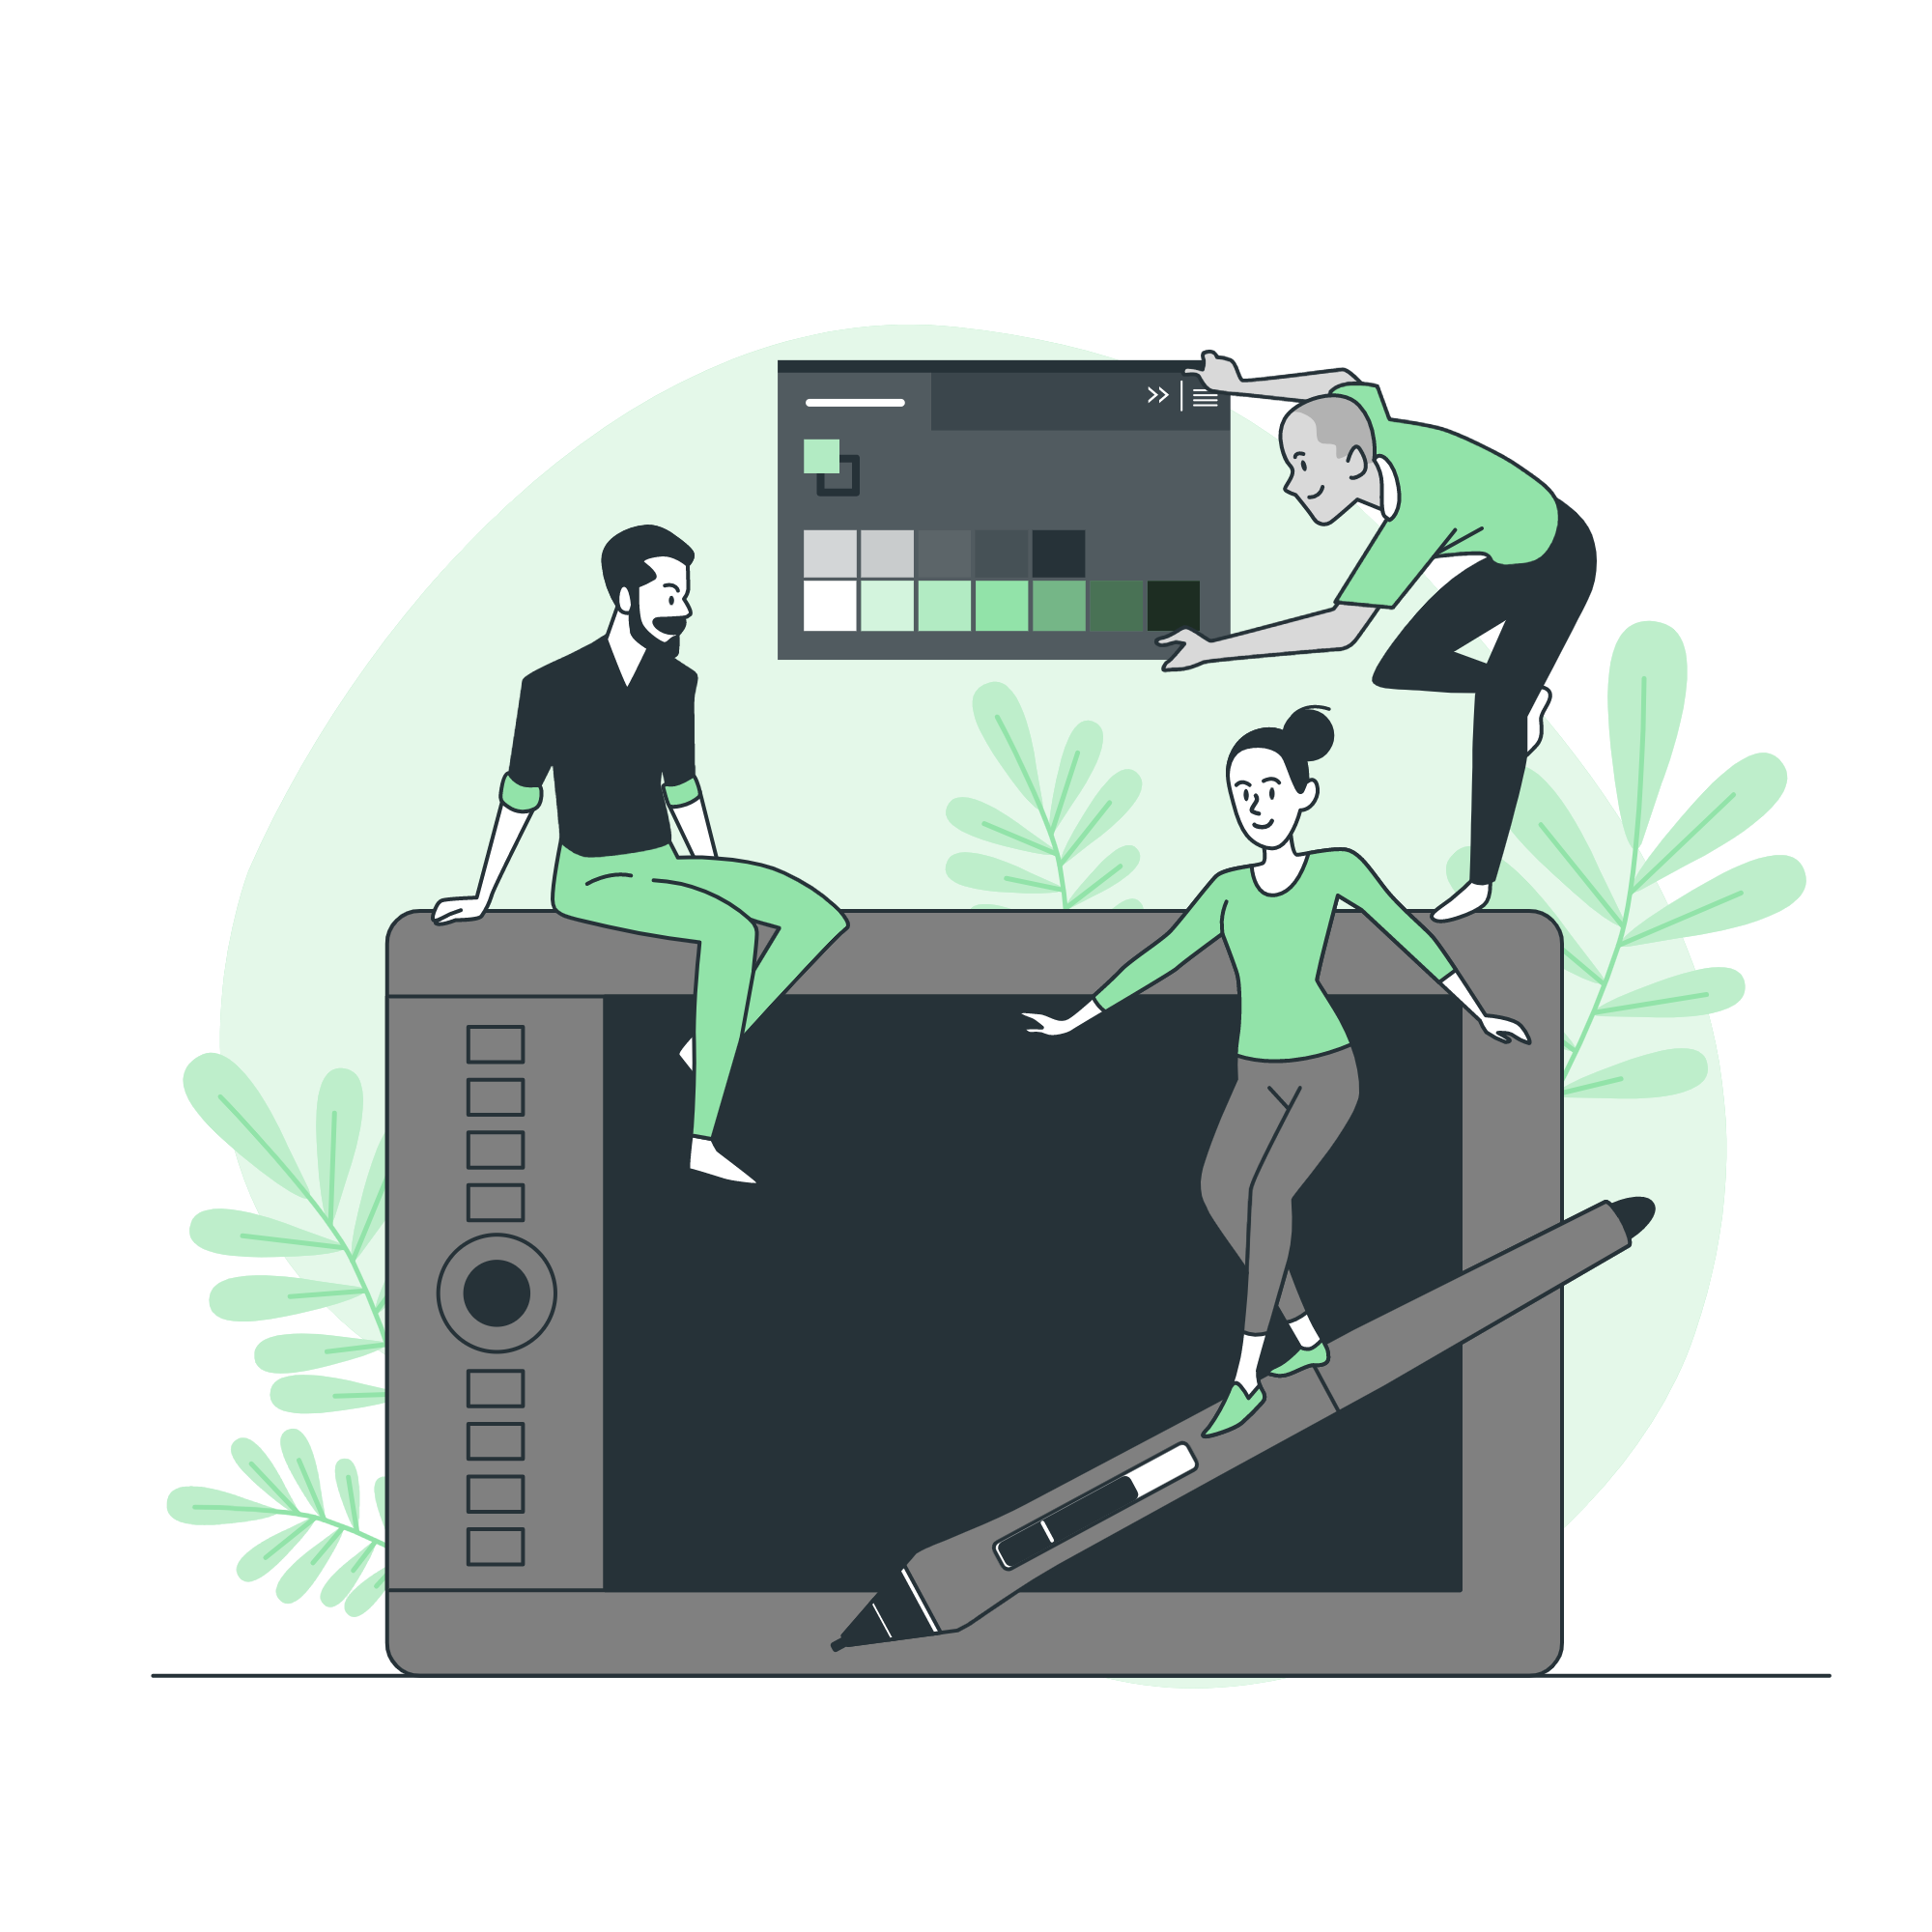



Storyset
Create your Story with our illustrated concepts. Choose the style you like the most, edit its colors, pick the background and layers you want to show and bring them to life with the animator panel! It will boost your presentation.
Check out how it works.
Pana
Amico
Bro
Rafiki
Cuate

Slide 43
Use our editable graphic resources...
You can easily resize these resources without losing quality. To change the color, just ungroup the resource and click on the object you want to change. Then, click on the paint bucket and select the color you want. Group the resource again when you’re done. You can also look for more infographics on Slidesgo.

Slide 46
JANUARY
FEBRUARY
MARCH
APRIL
MAY
JUNE
PHASE 1
Task 1
Task 2
PHASE 2
Task 1
Task 2
JANUARY
FEBRUARY
MARCH
APRIL
PHASE 1
Task 1
Task 2

Slide 49
...and our sets of editable icons
You can resize these icons without losing quality.
You can change the stroke and fill color; just select the icon and click on the paint bucket/pen.
In Google Slides, you can also use Flaticon’s extension, allowing you to customize and add even more icons.

Slide 50
Educational Icons
Medical Icons

Slide 51
Business Icons
Teamwork Icons

Slide 52
Help & Support Icons
Avatar Icons

Slide 53
Creative Process Icons
Performing Arts Icons

Slide 54
Nature Icons

Slide 55
SEO & Marketing Icons

Slide 56
